Slide 1

Mth 650 Data Analysis
Presented by :- Adeeda mukthar
Daniel Joshua
Shyam Verma
Shashi Vadhan
Vignesh Nagarajan

Slide 2

Tokyo 2021 Olympics

Slide 3
AGENDA
Introduction
Data Collection
Conclusion
Exploratory Data Analysis
Key Findings
Regression Analysis
Statistical Analysis

Slide 4
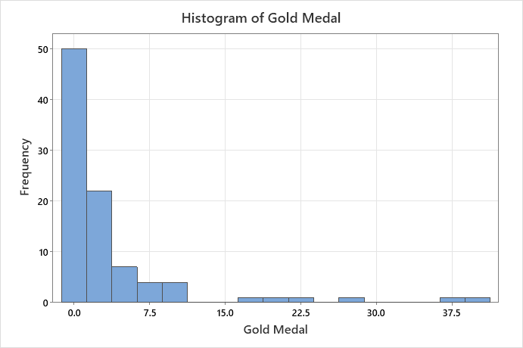
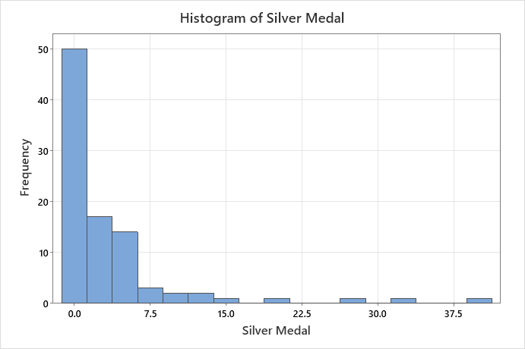
Exploratory Data Analysis (EDA)
Variable | Total Count | Mean | StDev | Median
Gold Medal | 93 | 3.65591 | 7.02247 | 1
Silver Medal | 93 | 3.63441 | 6.62634 | 1
Bronze Medal | 93 | 4.32258 | 6.21037 | 2
Total | 93 | 11.6129 | 19.0913 | 4
Summary Statistics: Calculate mean, median, standard deviation.
Distribution Plots

Slide 5
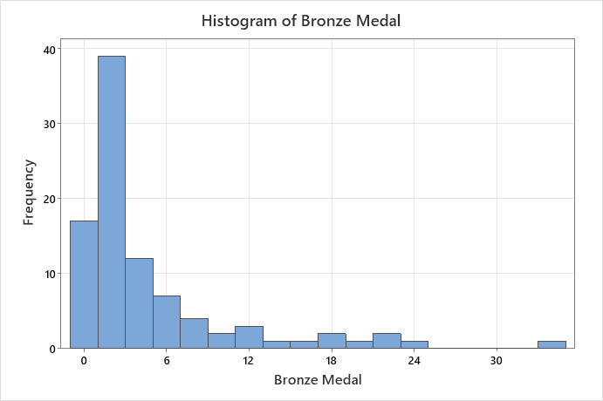
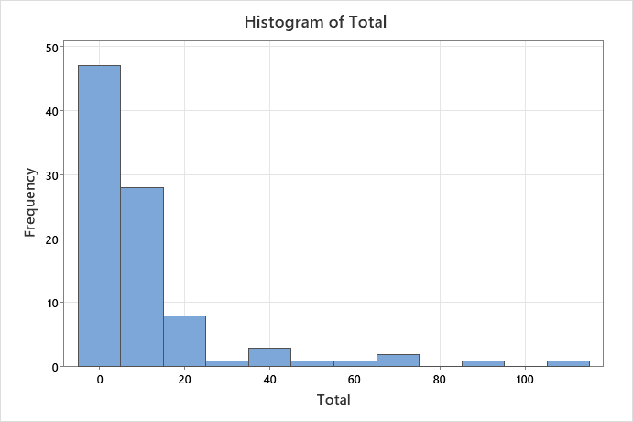

Slide 6
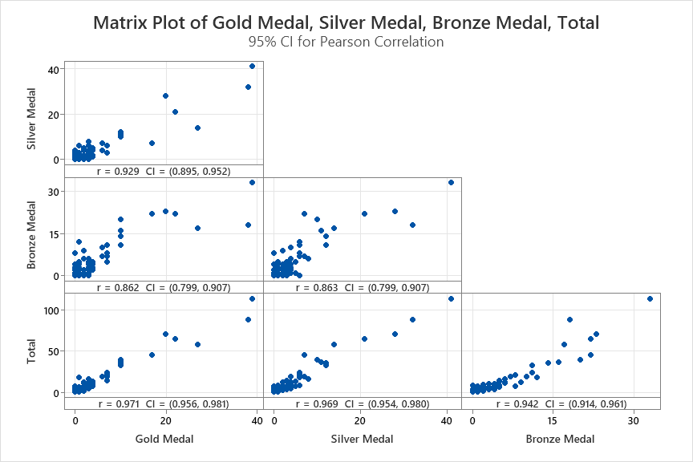
Correlation Analysis
Correlations
 | Gold Medal | Silver Medal | Bronze Medal
Silver Medal | 0.929
Bronze Medal | 0.862 | 0.863
Total | 0.971 | 0.969 | 0.942
Method
Correlation type | Pearson
Number of rows used | 93

Slide 7
Perform hypothesis tests (T-test)
Perform hypothesis tests (T-test): To compare means or check for statistical significance in medal counts across different groups (such as continents or previous Olympic performance).
One-Sample T: Gold Medal
One-Sample T: Silver Medal
Descriptive Statistics
Descriptive Statistics
N | Mean | StDev | SE Mean | 95% CI for μ
93 | 3.656 | 7.022 | 0.728 | (2.210, 5.102)
N | Mean | StDev | SE Mean | 95% CI for μ
93 | 3.634 | 6.626 | 0.687 | (2.270, 4.999)
μ: population mean of Gold Medal
μ: population mean of Silver Medal
Test
Test
Null hypothesis |  | H₀: μ = 3.5
Alternative hypothesis |  | H₁: μ ≠ 3.5
T-Value | P-Value
0.21 | 0.831
Null hypothesis |  | H₀: μ = 3.5
Alternative hypothesis |  | H₁: μ ≠ 3.5
T-Value | P-Value
0.05 | 0.960

Slide 8
Perform hypothesis tests (T-test)
One-Sample T: Bronze Medal
One-Sample T: Total
Descriptive Statistics
Descriptive Statistics
N | Mean | StDev | SE Mean | 95% CI for μ
93 | 4.323 | 6.210 | 0.644 | (3.044, 5.602)
N | Mean | StDev | SE Mean | 95% CI for μ
93 | 11.61 | 19.09 | 1.98 | (7.68, 15.54)
μ: population mean of Bronze Medal
μ: population mean of total
Test
Test
Null hypothesis H₀: μ = 4.32
Alternative hypothesis H₁: μ ≠ 4.32
T-Value | P-Value
0.00 | 0.997
Null hypothesis H₀: μ = 11.61
Alternative hypothesis H₁: μ ≠ 11.61
T-Value | P-Value
0.00 | 0.999

Slide 9
ANOVA (Analysis of Variance)
ANOVA: If you have more than two groups, use ANOVA to test for significant differences between means
One-way ANOVA:
Total versus Continent
Model Summary
Method
S | R-sq | R-sq(adj) | R-sq(pred)
18.0650 | 16.30% | 10.46% | *
Null hypothesis | All means are equal
Alternative hypothesis | Not all means are equal
Significance level | α = 0.05
Means
Factor Information
Continent | N | Mean | StDev | 95% CI
Africa | 14 | 2.714 | 2.614 | (-6.884, 12.312)
Asia | 22 | 10.77 | 21.12 | (3.12, 18.43)
Australia | 3 | 22.7 | 22.1 | (1.9, 43.4)
Europe | 38 | 11.97 | 13.51 | (6.15, 17.80)
Europe/Asia | 1 | 71.00 | * | (35.09, 106.91)
North America | 10 | 17.5 | 34.4 | (6.1, 28.9)
South America | 5 | 7.20 | 7.76 | (-8.86, 23.26)
Factor | Levels | Values
Continent | 7 | Africa, Asia, Australia, Europe, Europe/Asia, North America, South America
Analysis of Variance
Source | DF | Adj SS | Adj MS | F-Value | P-Value
Continent | 6 | 5466 | 911.1 | 2.79 | 0.016
Error | 86 | 28066 | 326.3
Total | 92 | 33532

Slide 10
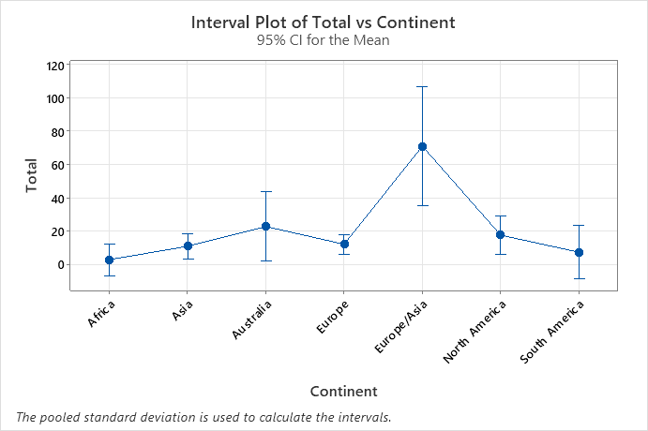
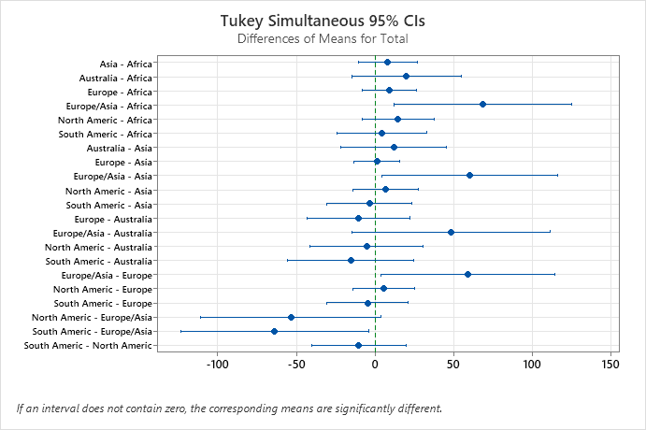
Tukey pairwise comparison
Grouping Information Using the Tukey Method and 95% Confidence
Continent | N | Mean | Grouping
Europe/Asia | 1 | 71.00 | A
Australia | 3 | 22.7 | A | B
North America | 10 | 17.5 | A | B
Europe | 38 | 11.97 |  | B
Asia | 22 | 10.77 |  | B
South America | 5 | 7.20 |  | B
Africa | 14 | 2.714 |  | B
One-way ANOVA: Total versus Continent
This Graph shows how to presents the total means for each continent.

Slide 11
1. What is ANOVA? • ANOVA (Analysis of Variance) is a statistical test used to compare the means of three or more groups. It helps determine whether the differences in means are significant or just due to random chance. • In simpler terms, ANOVA helps answer the question: "Are these groups different enough that we should pay attention to those differences?"
2. Why is ANOVA used in this medal analysis? • ANOVA is used here to compare the average number of medals won across different continents (like Africa, Asia, Australia, etc.). • The goal is to find out if some continents win significantly more medals than others. This could help us understand which continents have stronger athletic performances or resources that contribute to winning medals.
Why is ANOVA used in this medal analysis?
ANOVA is used here to compare the average number of medals won across different continents (like Africa, Asia, Australia, etc.).
The goal is to find out if some continents win significantly more medals than others. This could help us understand which continents have stronger athletic performances or resources that contribute to winning medals.

Slide 12
3. Findings from the Results and Images
Null Hypothesis: The test assumes that all the continents have equal mean medal counts.
Significance Level: A p-value of 0.016 was found, which is less than the significance level of 0.05. This means we reject the null hypothesis. In simple terms, there is a significant difference in the average number of medals won by at least one continent compared to the others.
Mean Results: Tukey Method Grouping: The results show that:
Europe/Asia and Australia belong to the top group (Group A), indicating they have significantly higher medal counts.
The rest of the continents (Africa, Asia, Europe, South America) fall into Group B, suggesting they do not significantly differ from each other but are lower compared to the top groups.
Conclusion: The analysis clearly indicates that some continents are significantly better at winning medals than others, particularly Europe/Asia, while Africa performs the least in this context.
Europe/Asia has the highest average of 71 medals, which stands out significantly from the others.
Australia follows with 22.7 medals, and North America with 17.5 medals.
The other continents (Africa, Asia, South America, and Europe) have much lower averages, with Africa having the lowest at 2.714 medals.
Tukey Method Grouping: The results show that:
Europe/Asia and Australia belong to the top group (Group A), indicating they have significantly higher medal counts.
The rest of the continents (Africa, Asia, Europe, South America) fall into Group B, suggesting they do not significantly differ from each other but are lower compared to the top groups.
Conclusion: The analysis clearly indicates that some continents are significantly better at winning medals than others, particularly Europe/Asia, while Africa performs the least in this context.

Slide 13
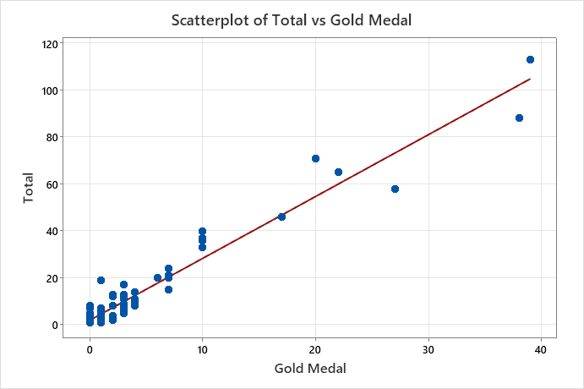
1. Simple Linear Regression:
Regression Analysis
Total versus Gold Medal
Model Summary
Equation
S | R-sq | R-sq(adj) | R-sq(pred)
4.60185 | 94.25% | 94.19% | 93.07%
Total | = | 1.964 + 2.6393 Gold Medal
Coefficients
Term | Coef | SE Coef | T-Value | P-Value | VIF
Constant | 1.964 | 0.539 | 3.65 | 0.000
Gold Medal | 2.6393 | 0.0683 | 38.63 | 0.000 | 1.00
Analysis of Variance
Source | DF | Adj SS | Adj MS | F-Value | P-Value
Regression | 1 | 31605.0 | 31605.0 | 1492.42 | 0.000
Gold Medal | 1 | 31605.0 | 31605.0 | 1492.42 | 0.000
Error | 91 | 1927.1 | 21.2
Lack-of-Fit | 12 | 1146.5 | 95.5 | 9.67 | 0.000
Pure Error | 79 | 780.6 | 9.9
Total | 92 | 33532.1
Gold Medals:
This indicates that about 94.25% of the variability in total medals can be explained by the number of gold medals. This is a very strong relationship

Slide 14
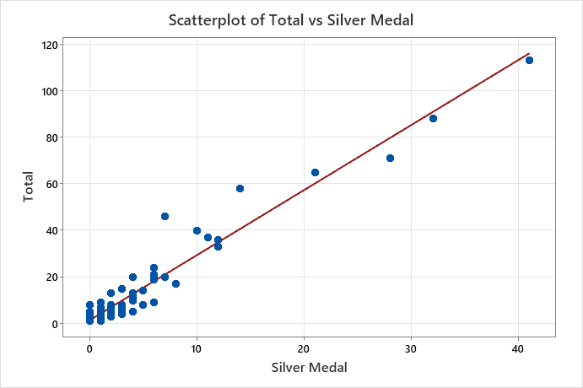
1. Simple Linear Regression:
Regression Analysis
Total versus Silver Medal
Model Summary
Equation
S | R-sq | R-sq(adj) | R-sq(pred)
4.70936 | 93.98% | 93.92% | 93.62%
Total | = | 1.462 + 2.7931 Silver Medal
Coefficients
Term | Coef | SE Coef | T-Value | P-Value | VIF
Constant | 1.462 | 0.558 | 2.62 | 0.010
Silver Medal | 2.7931 | 0.0741 | 37.70 | 0.000 | 1.00
Analysis of Variance
Source | DF | Adj SS | Adj MS | F-Value | P-Value
Regression | 1 | 31513.9 | 31513.9 | 1420.95 | 0.000
Silver Medal | 1 | 31513.9 | 31513.9 | 1420.95 | 0.000
Error | 91 | 2018.2 | 22.2
Lack-of-Fit | 15 | 1020.2 | 68.0 | 5.18 | 0.000
Pure Error | 76 | 998.0 | 13.1
Total | 92 | 33532.1
Silver Medals:
Similarly, around 93.98% of the variability in total medals is explained by silver medals, also showing This is a strong relationship.

Slide 15
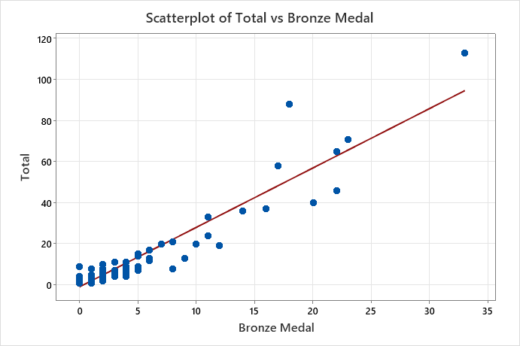
1. Simple Linear Regression:
Regression Analysis
Total versus Bronze Medal
Model Summary
Equation
S | R-sq | R-sq(adj) | R-sq(pred)
6.44557 | 88.73% | 88.60% | 86.84%
Total | = | -0.904 + 2.896 Bronze Medal
Coefficients
Term | Coef | SE Coef | T-Value | P-Value | VIF
Constant | -0.904 | 0.816 | -1.11 | 0.271
Bronze Medal | 2.896 | 0.108 | 26.76 | 0.000 | 1.00
Analysis of Variance
Source | DF | Adj SS | Adj MS | F-Value | P-Value
Regression | 1 | 31513.9 | 31513.9 | 1420.95 | 0.000
Silver Medal | 1 | 31513.9 | 31513.9 | 1420.95 | 0.000
Error | 91 | 2018.2 | 22.2
Lack-of-Fit | 15 | 1020.2 | 68.0 | 5.18 | 0.000
Pure Error | 76 | 998.0 | 13.1
Total | 92 | 33532.1
Bronze Medals:
While bronze medals explain 88.73% of the variability, this is lower than gold and silver, indicating a weaker relationship with total medals.

Slide 16
Logistic Regression Analysis
Binary Logistic Regression: Medal New versus Gold Medal, Silver Medal
Odds Ratios for Continuous Predictors
 | Odds Ratio | 95% CI
Gold Medal | 2.2055 | (1.1164, 4.3568)
Silver Medal | 2.7422 | (1.4206, 5.2933)
Response Information
Variable | Value | Count
MedalNew | 1 | 24 | (Event)
 | 0 | 69
 | Total | 93
Gold Medal Odds Ratio: 2.2055 This value indicates that for each additional gold medal, the odds of winning more than the specified number of total medals increase significantly. Since it's greater than 0.5, it shows a strong positive effect.
Silver Medal Odds Ratio: 2.7422 Similarly, this odds ratio indicates that each additional silver medal substantially boosts the odds of winning more overall medals. Again, being greater than 0.5 highlights its important impact
Coefficients
Term | Coef | SE Coef | Z-Value | P-Value | VIF
Constant | -6.44 | 1.55 | -4.16 | 0.000
Gold Medal | 0.791 | 0.347 | 2.28 | 0.023 | 1.00
Silver Medal | 1.009 | 0.336 | 3.01 | 0.003 | 1.00
Model Summary
Deviance R-Sq | Deviance R-Sq(adj) | AIC | AICc | BIC | Area Under ROC Curve
76.29% | 74.41% | 31.18 | 31.45 | 38.78 | 0.9852

Slide 17
Major key points Tokyo 2021 Olympics
What statistical tests were used to analyze the relationship between different types of medals and total medal counts?
Correlation analysis.
Simple linear regression.
ANOVA for comparing continents.
How do gold, silver, and bronze medals contribute to the overall performance of a country?
Gold and silver medals have a strong positive impact on total medals.
Bronze medals show a weaker relationship with total medals.
What were the key insights from the ANOVA test across continents?
Significant difference in medal counts between continents.
Europe/Asia and Australia outperformed other continents.
Africa had the lowest performance.
What are the significant differences in performance between continents in terms of medal counts?
Europe/Asia leads with the highest average medals.
Africa performed the worst.
Other continents fall into intermediate groups.
How strong is the correlation between gold medals and total medals compared to silver and bronze medals?
Gold: Very strong (explains 94.25% of variability).
Silver: Also strong (93.98%).
Bronze: Slightly weaker (88.73%).

Slide 18
Major key points Tokyo 2021 Olympics
Why is it important to perform hypothesis testing in Olympic medal analysis?
To check if observed differences are statistically significant.
Validates findings across different groups (countries or continents).
What can be inferred from the logistic regression performed on medal counts?
Gold and silver medals significantly increase the odds of winning more total medals.
Both medal types have a strong positive effect on total success.
How do historical or geographical factors impact the performance of countries in the Olympics?
Certain continents consistently perform better due to resources, training infrastructure, or historical dominance.
Geographic factors influence success distribution.
Overall Conclusion:
Europe/Asia leads in overall Olympic performance with the highest medal counts.
Gold and silver medals are the strongest predictors of total medal success.
Significant differences exist between continents, with Europe/Asia and Australia outperforming others, while Africa lags behind.
Medal counts are heavily influenced by geographic, historical, and resource factors, suggesting that some regions have better athletic infrastructure and support systems.

